Slide 1
Enteric –bacteria

Slide 2
Enteric bacteria
Enteric bacteria are bacteria of the intestines, and may refer to:
Gut flora, which are always present and usually harmless
Pathogenic bacteria of bacterial gastroenteritis
The taxonomic family Enterobacteriaceae

Slide 3
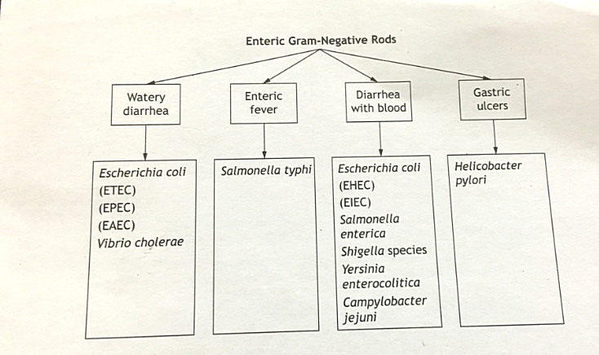

Slide 4
Traveler’s Diarrhea
Organism :Enterotoxigenic Escherichia coli (ETEC)
Physical characters :gram negative rod, lactose fermentation .
Etiology and epidemiology: transmission is by ingestion of contaminated food or water . ETEC is a common cause of Traveler’s Diarrhea.
Clinical manifestation: watery diarrhea is the main clinical manifestation.
Pathogenesis: ETEC secretes two different toxins , heat-labile and heat-stable enterotoxin. The bacteria adhere to intestinal epithelial cells but do not invade.
Laboratory diagnosis: many E.coli ferment lactose and sorbitol ,can be grown on a variety of selective and differential media.e.g.(MacConkey agar , EMB and other).toxin genes can be detected by polymerase chain reaction .strain identification is based on serotype analysis of O, H,and K antigens.
Treatment and prevention: Watery diarrhea is generally self limiting and treated with fluid replacement . Diarrheal disease is best prevented by avoiding improperly cooked foods and unpurified water.

Slide 5
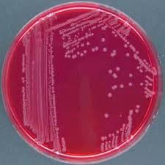
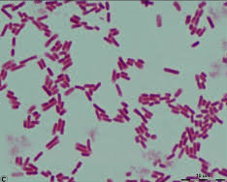
Gram stain of E.coli
E.coli on MacConky agar

Slide 6
Hemorrhagic Colitis
Organism :Enterohemorrhagic Escherichia coli (EHEC)
Physical characters :gram negative rod, E.coli strain O157:H7.
Etiology and epidemiology: transmission is by ingestion of contaminated food or water . Outbreaks have occurred from a wide variety of sources including undercooked hamburger ,unpasteurized apple juice, and contaminated water in swimming pools and water parks. EHEC infection require a very small infective dose that can be as low as 50 to 100 organisms.
Clinical manifestation:EHEC causes hemorrhagic colitis and can progress to hemolytic uremic syndroum (HUS).
Pathogenesis:the major virulence factor of EHEC is Shiga-like toxin . Shiga toxin targets and cleaves 28S RNA, resulting in a shut down of protein synthesis and cell death.EHEC adhere to colonic epithelial cells and secrete toxin that is absorbed by the host cell .destruction of glomerulare endothelial cells results in acute kidney failure and HUS.
Laboratory diagnosis:EHEC can be differentiated from other E.coli by its inability to ferment sorbitol.
Treatment and prevention: infection are treated with supportive measures and antibiotics are generally not used .antibiotics have not been shown to alter the disease course and may actually increase the risk for development of HUS.

Slide 7
Infant Diarrhea
Organism :Enteropathogenic (EPEC)and Enteroaggregative(EAEC)Escherichia coli
Physical characters :gram negative rod, lactose fermentation .
Etiology and epidemiology:EPEC and EAEC are associated with infant diarrhea, especially in underdeveloped countries.
Clinical manifestation: watery diarrhea often accompanied by vomiting.
Pathogenesis: EPEC secretes two different toxins , heat-labile and heat-stable enterotoxin. The bacteria adhere to intestinal epithelial cells but do not invade. EAEC causes destruction of microvilli and decreased fluid absorption
Treatment and prevention: Watery diarrhea is generally self limiting and treated with fluid replacement . Diarrheal disease is best prevented by avoiding improperly cooked foods and unpurified water.

Slide 8
Bacillary Dysentery
Organism: Enteroinvasive Escherichia coli (EIEC)
Etiology: most often associated with disease in underdeveloped countries
Clinical manifestation: Dysentery
Pathogenesis: The bacteria attaches and invades colonic epithelial cells, resulting in cell death and inflammation. The disease process is very similar to that of Shigella.
Treatment: symptomatic treatment .The disease is self-limiting.

Slide 9
Enteric Fever (Typhoid Fever)
Organism: Salmonella typhi (Gram-negative rod).
Etiology: The only reservoir of S. typhi is humans. Infection occurs after ingestion
of contaminated food or water. Individuals can become chronic carriers, shedding
bacteria in stools for months to years, therefore acting as endemic reservoirs.
Clinical manifestation: Salmonella typhi is the causative agent of typhoid fever. The disease starts
with gastrointestinal symptoms and progresses to systemic disease. Fever
can last 3 to 4 weeks.
Pathogenesis: Salmonella typhi has two major virulence factors, Vi polysaccharide capsule and
endotoxin. Like other Salmonella , Salmonella typhi invades intestinal mucosal cells,
replicates in endosomes, and is transported to the sub-epithelial layer. Here they
are engulfed by macrophages, survive and enter lymphatics and blood. Replication in
spleen and liver leads to long-term release of endotoxin. The carrier state is
characterized by colonization of the gallbladder.
Laboratory Diagnosis: S typhi can be isolated from blood culture in the first week of illness.
Treatment and Prevention: a variety of antibiotics can be used to control the course of infection including: Ampicillin, Chloramphenicol, Trimethoprim, Ceftriaxone, and Ciprofloxacin.
Prevention involves proper sanitation, carriers not handling food and vaccination
against Vi polysaccharide.

Slide 11
Bacillary Dysentery
Organism: Shigella (Gram-negative rod ,4 species: S dysentericae, S flexneri, S bodydii, and S sonnei).
Etiology: Transmission is most often by feca-oral spread.Very few organisms (100-2 are required to cause infection.
Clinical manifestation: Shigella causes dysentery that is clinically similar to that caused by enteroinvasive E coli (EIEC). Symptoms include fever, abdominal cramps, and blood and mucous
diarrheal stool . S dysentericae also produces Shiga toxins, which is associated with
more serious disease and development of hemolytic uremic syndrome.
Pathogenesis: : Shigella carries a number of virulence factors including genes required for invasion,
endotoxin and Shiga toxin. As with Salmonella ,Shigella invades through intestinal
mucosal cells. It then escapes the endosomes, replicates in the cytoplasm, spreads to the
adjacent enterocytes. Cell destruction induces a host inflammatory response.Shiga toxin
is not required for dysentery.
Laboratory Diagnosis: like Salmonella, Shigella are lactose fermenters and can be isolated on a variety of selective and differntial media from stool cultures. Shigella do not produce H2S and are nonmotile.
Treatment and Prevention: Fluid and electrolyte replacement is often adequate for mild cases, whereas antibiotics such as ciprofloxacin and trimethoprim can be used for more serious disease. Prevention involves proper sanitation and good personal hygiene.

Slide 12
